Slide 1
Scientific calculator using Tkinter
A python GUI application with scientific calculation

Slide 2
Introduction
This scientific calculator is built using Tkinter in vs code
It include both basic and scientific functionalities such as :
-Arithmetic operations
-Trigonometric function (sin,cos,tan)
-Logarithm functions(log,in)
-Square root, exponent power

Slide 3
GUI and Layout
The calculator GUI is created using Tkinter widgets.
-Entry widget for input /output.
-Buttons arranged using grid layout.
-Separate commands for each button including scientific functions.

Slide 4
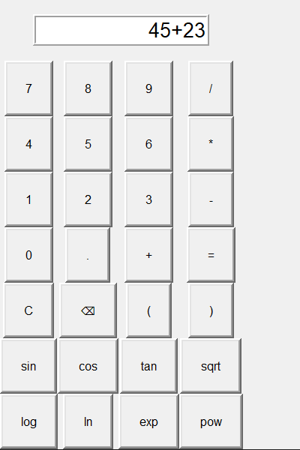
Calculator Interface

Slide 5
Functions and Logic
-press():Appends digits/operators to expression
-clear():Clears the display
-Backspace(): Remove last character
-Calculator():Uses eval() securely with math module
-Scientific_func():Handles functions like sin,cos,log etc.

Slide 6
Thank You

